Slide 1
Introduction To Data Science
Topic: Default Of Credit Card Clients
Group Id: 1
Group Members:
Mohsin Basti L1f16bscs0049
Abdullah Shafique L1f16bscs0159
Rehmat Ali Haider L1s16bscs0021

Slide 2
introduction
Motivation:
Banks play an vital role in providing financial services to people/country etc.
To avoid any loss, banks must be careful while investing or giving loans to people.
Our motivation was to make such an application which will help banks to get to know about the potential of customers to whom bank is going to give loan.
Our application will help the banks to know whether the customers will be able to pay
credit card payment next month or not.

Slide 3
INTRODUCTION
Location of Data Source:
We get this dataset from UCI website: http://archive.ics.uci.edu/ml/datasets/default+of+credit+card+clients
Dataset Name:
“Default of Credit Card Clients”
Dimensions of Dataset:
Rows: 30000, Columns: 25

Slide 4
Introduction
Education Variable:
Education variable represent qualification of customer/client.
Marriage Variable:
This variable represent marital status of client. 1 = married, 2 = single, 3 = others
PAY_0, PAY_2, PAY_3, PAY_4, PAY_5, PAY_6:
These variables represent repayment status in months. -2 = no consumption, -1 = pay duly, 0 = use of revolving credit, 1 = payment duly for 1 month, 2 = payment duly for 2 months ……….. 9 = payment duly for 9 months
BILL_AMT1, BILL_AMT_2, BILL_AMT3, BILL_AMT4, BILL_AMT5, BILL_AMT6:
This variable represent amount of bill statement in different months
PAY_AMT1, PAY_AMT2, PAY_AMT3, PAY_AMT4, PAY_AMT5, PAY_AMT6:
This variable represent amount of previous payments in different months.
Default_payment_next_month:
This variable represent default of credit card client next month. 0 = no default, 1 = default.

Slide 5
INTRODUCTION
Libraries:
1: ggplot2 11: plyr
2: naivebayes 12: caTools
3: randomforest 13: naniar
4: dplyr 14: e1071
5: neuralnet 15: readxl
6: caret
7: rpart
8: rpart.plot
9: class
10: tidyr

Slide 6
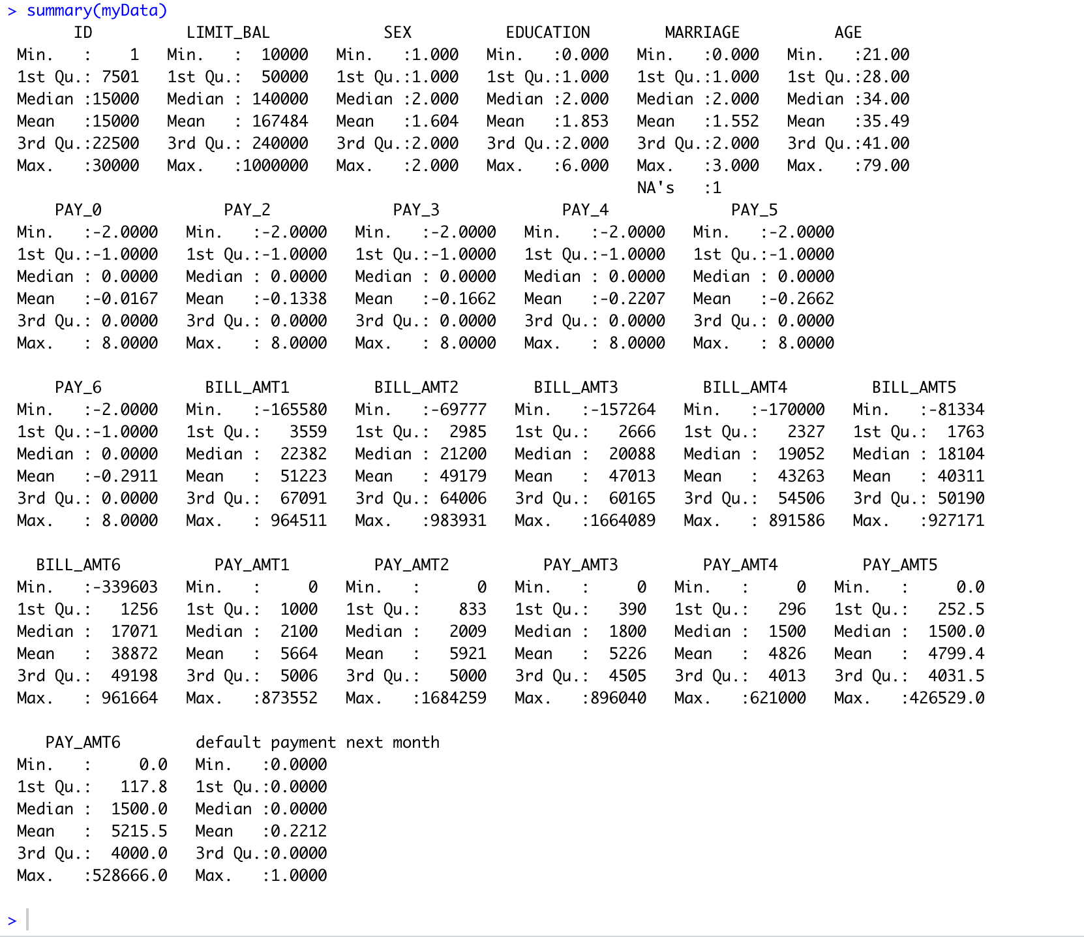
Data exploration
Summary of Data:

Slide 7
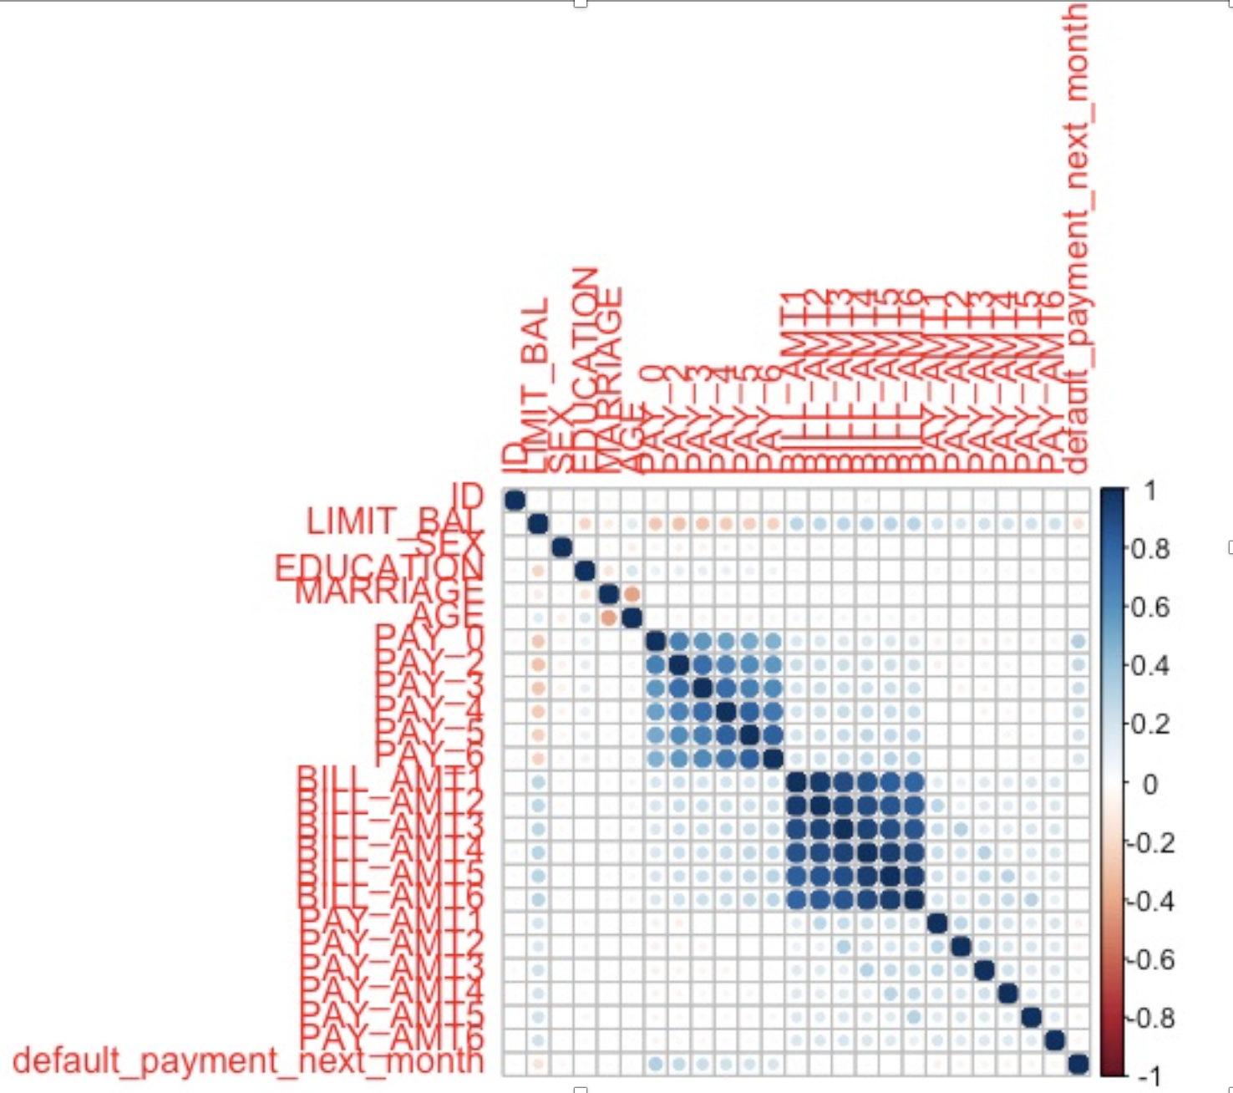
Correlation

Slide 8
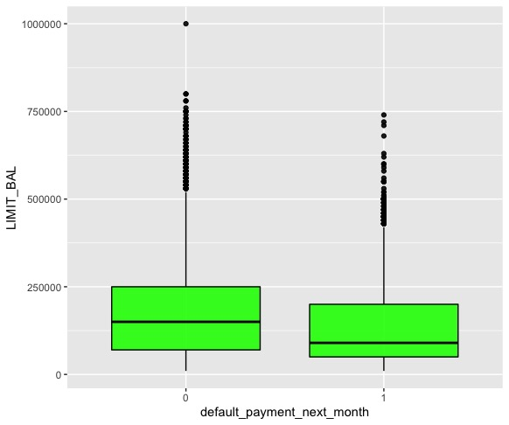
Box plot

Slide 9
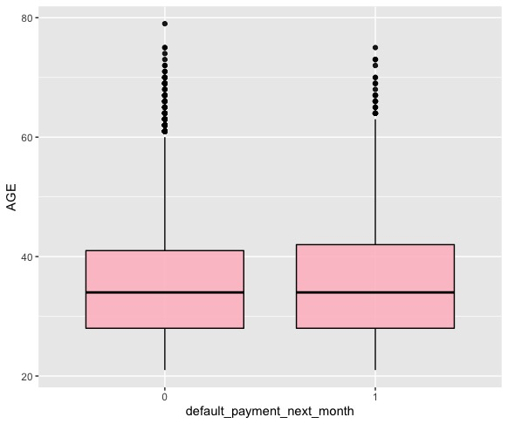
Box plot

Slide 10
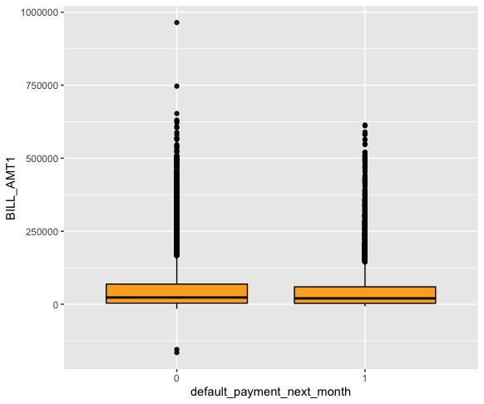
Box plot

Slide 11
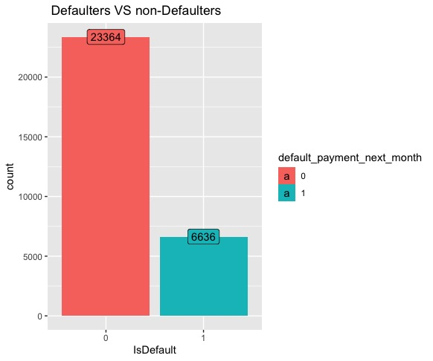
Bar plot

Slide 12
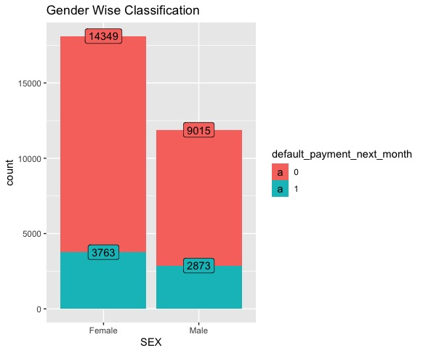
BAR PLOT

Slide 13
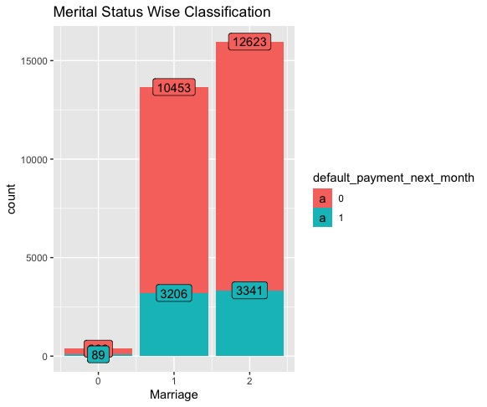
Bar plot

Slide 14
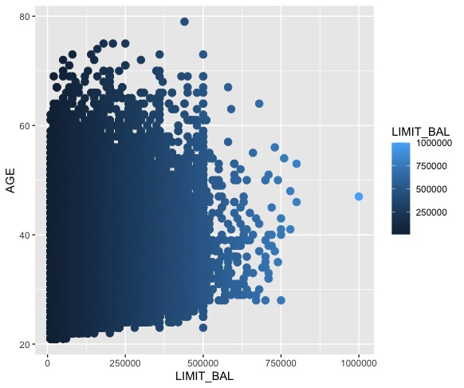
Dot plot

Slide 15
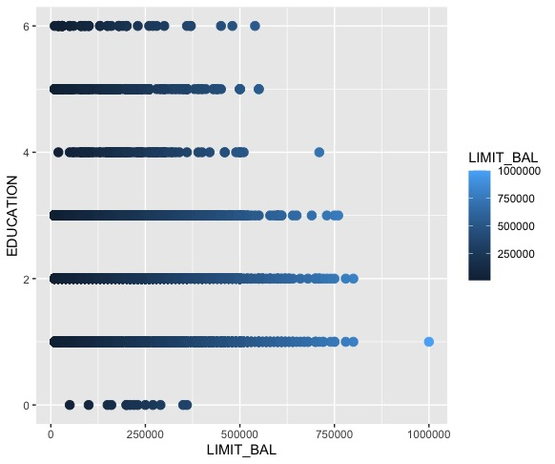
Dot plot

Slide 16
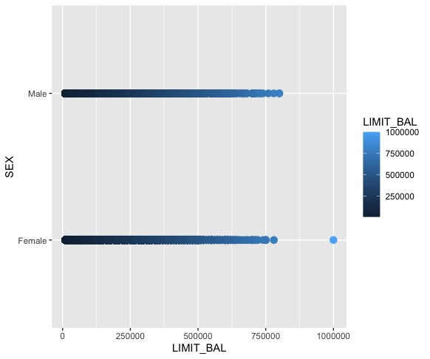
Dot plot

Slide 17
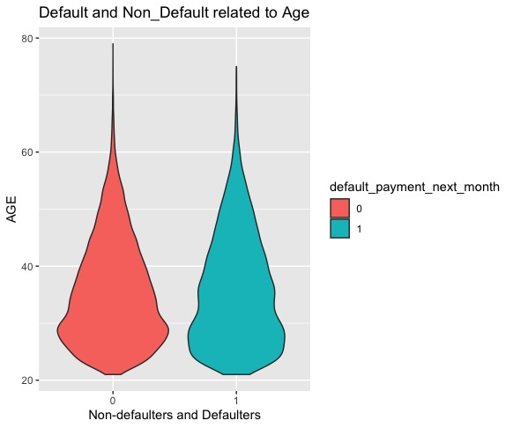
Violin plot

Slide 18
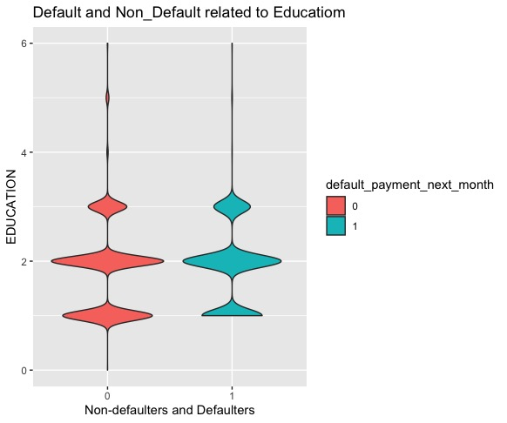
Violin plot

Slide 19
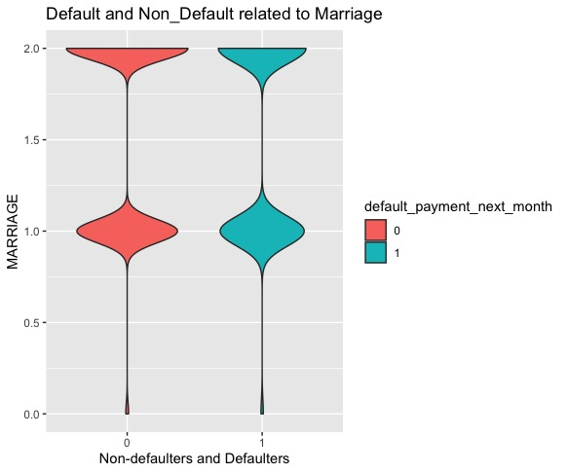
Violin plot

Slide 20
Machine learning modelling
Machine Learning Models Used in our projects:
Random Forest
SVM
Naïve Bayes
Decision Tree
Classification Neural Network

Slide 21
Detail of machine learning models
SVM Model:
75% data was used for training and 25% data was used for testing
Accuracy was 81%
Decision Tree:
80% data was used for training and 20% data was used for testing
Accuracy was 82%
Naïve Bayes:
75% data was used for training and 25% data was used for testing
Accuracy was 69.72%
Random Forest:
80% data was used for training and 20% data was used for testing
Accuracy was 79.76

Slide 22
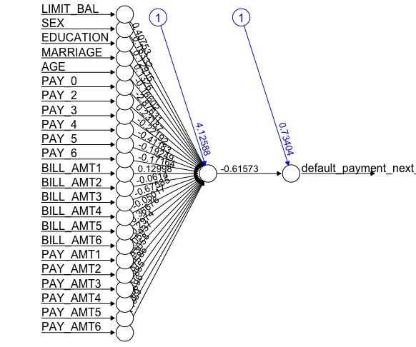
Detail of machine learning models
Classification Neural Network:
80% data was used for training and 20% data was used for testing
Accuracy was 81.14%

Slide 23
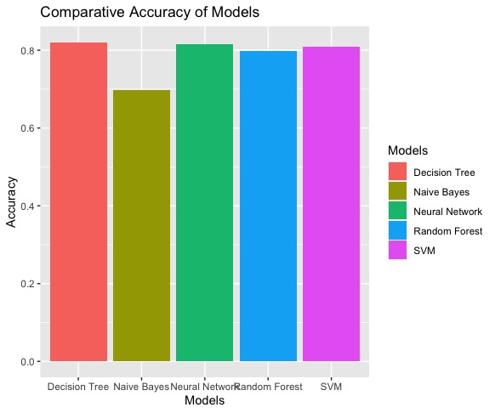
Machine learning models accuracy comparison

Slide 24
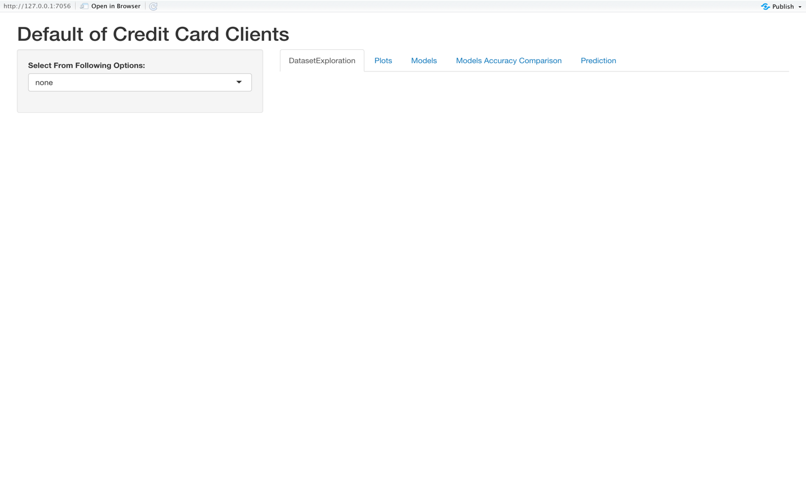
Shiny application
Shiny application we have made for our project is interactive. It consists of 5 tabs name as “DataExploration”, “Plots”, “Models”, “Models Accuracy Comparison”, and “Prediction”.

Slide 25
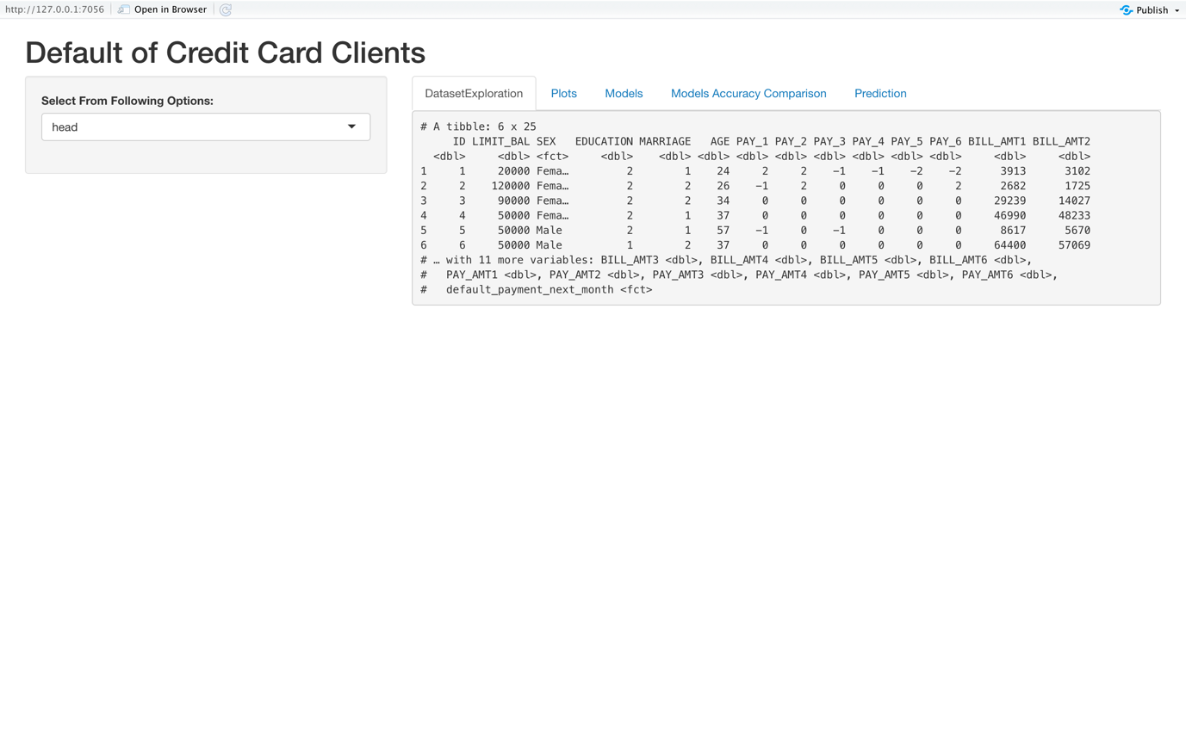
Shiny application
First tab “DataExploration” have a drop-down menu in the sidebar, drop-down menu has many options for data exploration. After selecting data exploration type from drop-down menu, the respective result will be displayed in the main panel.

Slide 26
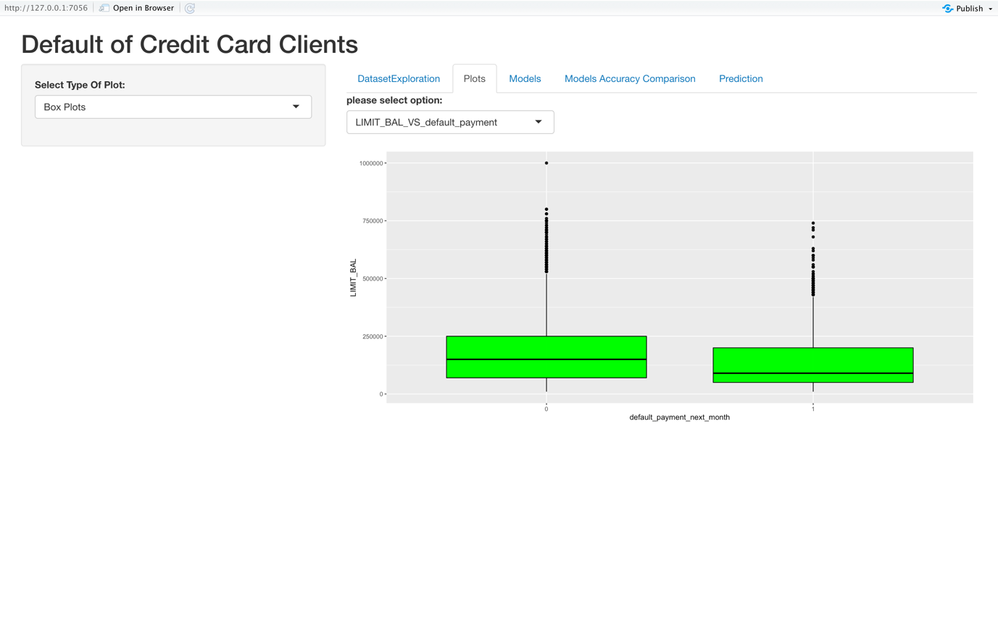
Shiny application
There comes “Plot” tab, which have a drop-down menu in the sidebar, drop-down menu has many options for different type of graphs. After selecting plot type from drop-down menu, the respective plot will be displayed in the main panel. Some graph types have further plot options for attributes.

Slide 27
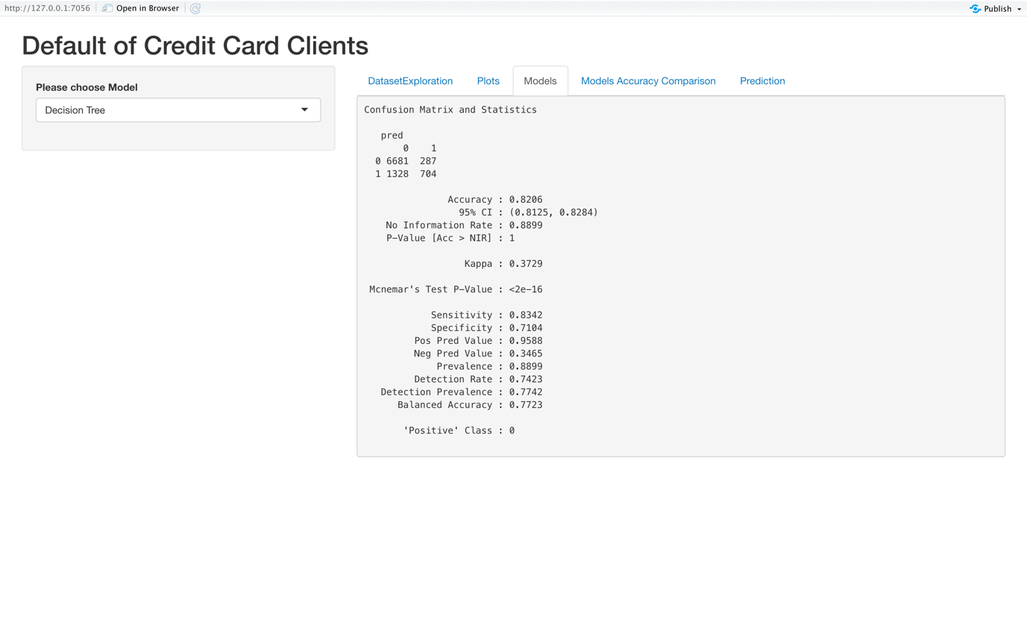
Shiny application
Then it comes “Models” tab, which have a drop-down menu in the sidebar, drop-down menu has many options for different type of models. After selecting model type from drop-down menu, the respective accuracy detail of model will be displayed in the main panel.

Slide 28
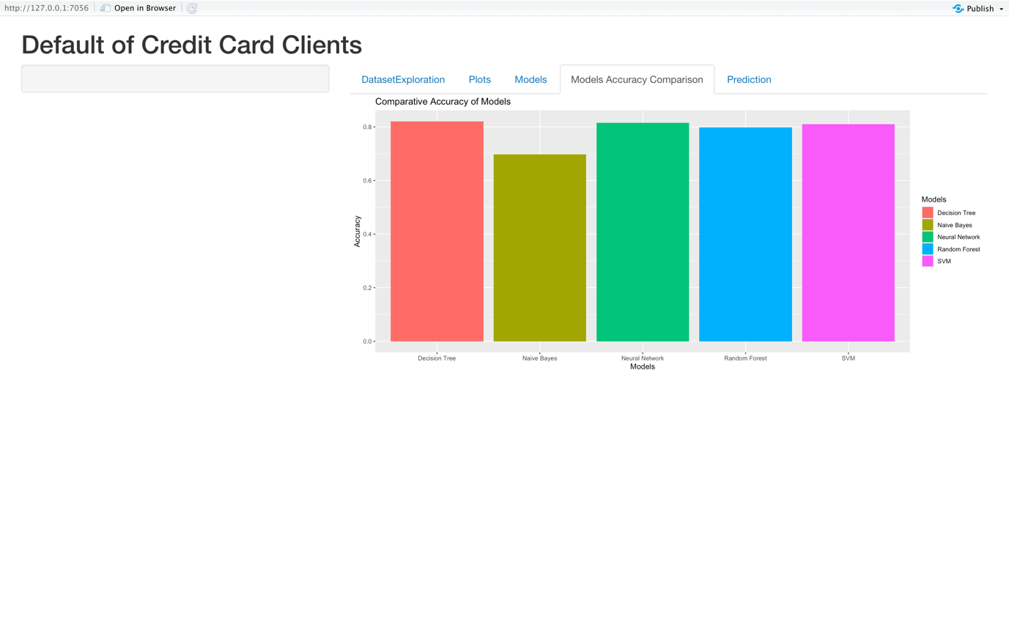
Shiny application
There comes “Models Accuracy Comparison” tab, which will display the accuracy comparison graph of all models trained in our project.

Slide 29
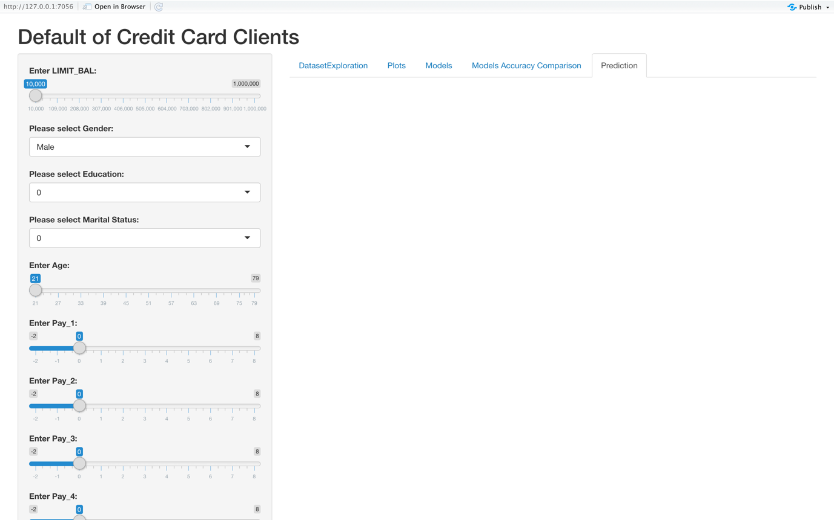
Shiny application
There comes the “Prediction” tab, in which we will adjust different inputs according to our requirements. Then according to selected inputs, the prediction will be done and after clicking on show output button, the prediction result will be displayed in the main panel.

Slide 30
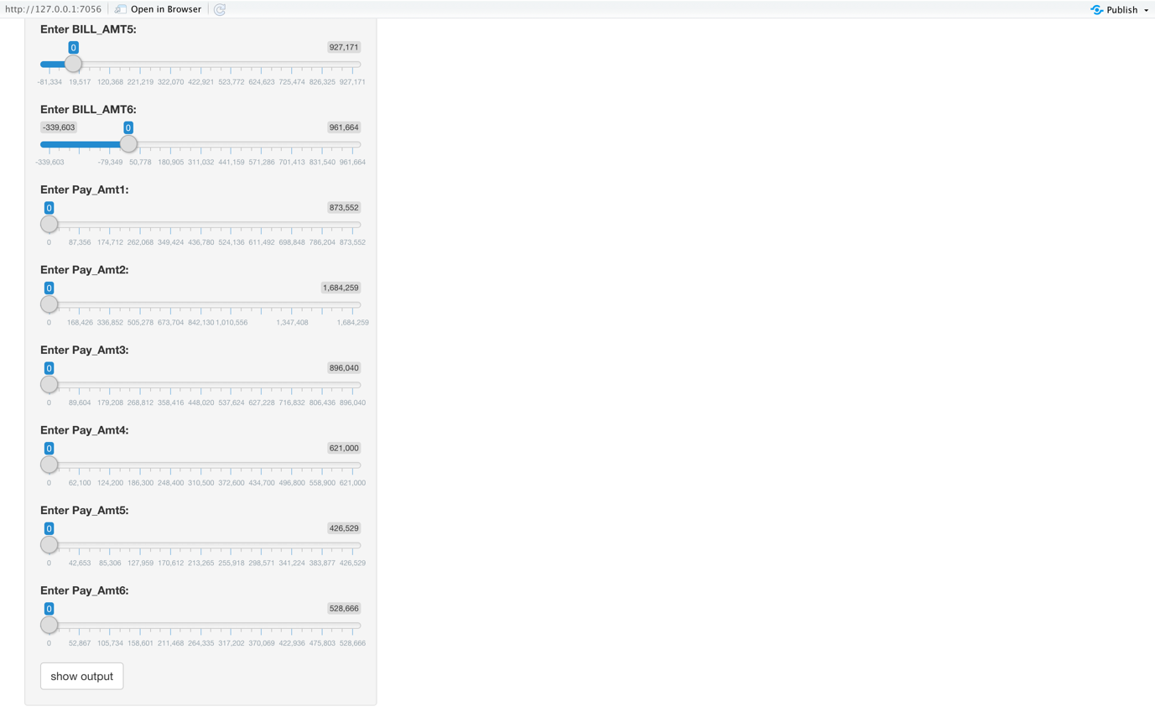
Shiny application

Slide 31
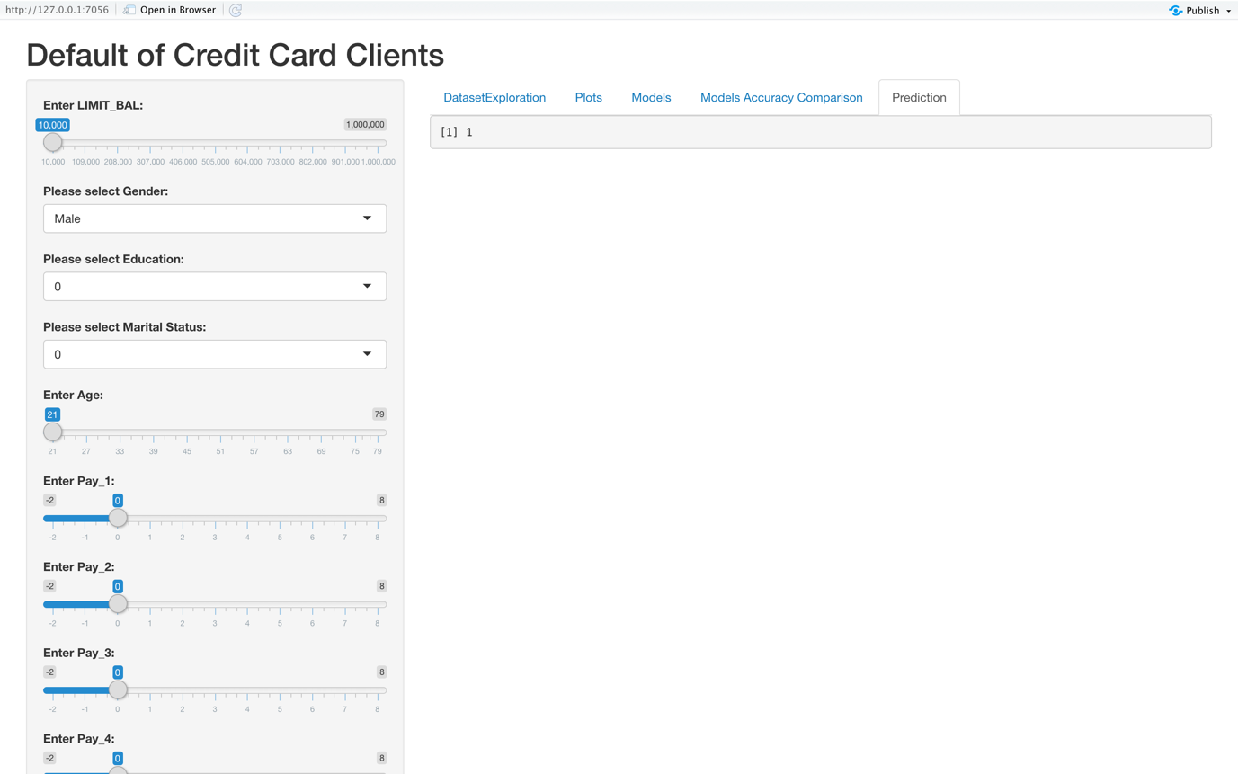
Shiny application

